Slide 1
Code Contract
Static & dynamic

Slide 2
Code Contract Example
Check
PreCondition
PostCondition
Object Invariant
Code Contracts - user manual page 6

Slide 3
Contract for Property
Code Contracts - user manual page 10

Slide 4
Assert & Assume
Code Contracts - user manual page 11

Slide 5
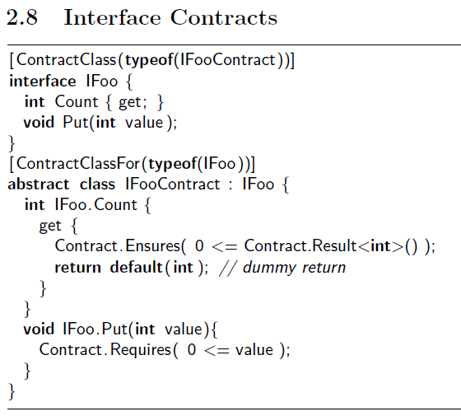
Set and interace
Code Contracts - user manual page 11-12

Slide 6
Abstract class
Code Contracts - user manual page 13

Slide 7
Abstract Methods
Code Contracts - user manual page 13

Slide 8
Contract Ordering
Code Contracts - user manual page 24

Slide 9
Purity
Code Contracts - user manual page 24

Slide 10
Contract Property Pane
Code Contracts - user manual page 25

Slide 11
Runtime Checking Level
Code Contracts - user manual page 26

